Slide 1
A High-Level Overview of the Federal Health Information Model (FHIM)
Galen Mulrooney (J P Systems), Lead Modeler

Slide 2
What is the FHIM? – Viewpoint 1 (of 2)
A model of the “business” (or clinical) concepts involved in the provision and administration of healthcare, independent of how those concepts are implemented
Can be thought of as a visual data dictionary
A model of health data needed by federal agencies for agency (i.e., “enterprise”) operations and for interoperability
It is the Data Reference Model (DRM) for the Federal Enterprise Architecture (FEA) Health Segment, thus the basis of each agency’s DRM

Slide 3
What is the FHIM? – Viewpoint 2 (of 2)
A model of the superset of the standards that each agency (and private practice in the US) must implement
These standards have overlaps and gaps (even from the same standards body) – FHIM provides a holistic view
Most standards are defined in terms of the technology in which they’re implemented, making it difficult (and expensive) to reuse code – FHIM can generate the code
Most standards leave critical terminology decisions up to the implementer, making interoperability impossible without additional agreements – FHIM defines the value-sets to be used, utilizing national terminology standards

Slide 4
Why the FHIM?
The FHIM provides a conceptual context for all system data and interactions (e.g., database, user interface, enterprise reporting, medical research, interoperability design, etc.)
The FHIM can be used to generate software compliant to different standards, saving money and improving accuracy
The FHIM can be used to generate implementation guides which can be balloted by the appropriate standards body to promote new interoperability standards
The FHIM can be used to generate code that tests conformance to the FHIM-generated interoperability standard
ONC and NIST uses code generated by MDHT to test C-32 and C-CDA conformance claims

Slide 5
Practical Implications
The FHIM could be used to generate FHIR Profiles for the US Realm, as well as for common agency needs (e.g., Military Rank and Grade, Indian Tribe, etc.)
The FHIM provides context that is missing in many standards, so it can be used to tie the granular pieces defined by FHIR, CIMI, even v2, together into coherent interactions
The FHIM can be used by CIMI to define CIMI “Reference Archetypes”, which form the basis of all CIMI “Detailed Clinical Models”
The FHIM can be used to define standard structures used by Clinical Decision Support systems

Slide 6
Walk-through of the FHIM

Slide 7
MDA Transforms to Other Models
Conceptual Model (CIM)
Model to Model Transformations
Payload PSM
Database PSM
Java Object PSM
Model to Implementation Transformations
Database
Java Application
Payload

Slide 8
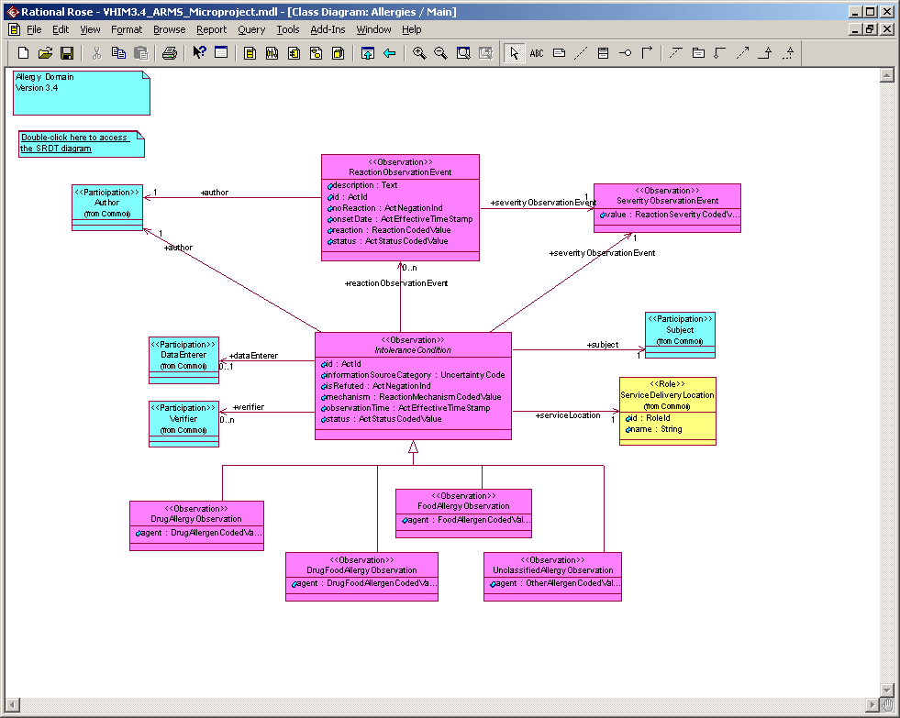
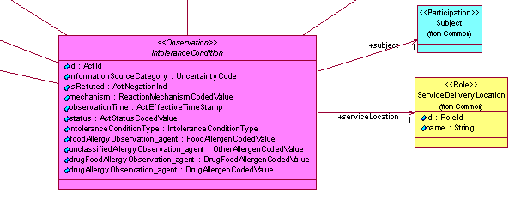
CIM to PSM Example
Note the transformation from one model that has four subclasses to distinguish the type of the allergy, to another model that has a single class which uses an allergy type to distinguish the type of allergy

